Slide 1

Property Rental & Lease Management System
DBMS Project-Based Learning – Review 3
PRESENTED BY
Mohammad Zeeshan • Roll No. 25WU0102160

Slide 2
From Database to Working Application
Application Architecture
Key Capabilities
User
■ Property and unit management
■ Tenant and lease management
■ Rent and payment tracking
■ Maintenance management
■ Reports and database-driven insights
■ CRUD operations with validation
↓
PropertyDesk UI
↓
Python Application
↓
MySQL Database
PropertyDesk transforms the normalized rental-management database into a working application connected to MySQL.
Database Design
→
Database Implementation
→
PropertyDesk Application
→
Working UI + CRUD + Reports
2

Slide 3
Technology & Implementation
DATABASE
BACKEND
FRONTEND
CONNECTIVITY
MySQL 8.0
Python
HTML, CSS, JavaScript
MySQL Connector
Implementation Highlights
■ 12 normalized database tables (database: smartnest_db)
■ Primary and foreign key constraints
■ CHECK / NOT NULL / UNIQUE / DEFAULT constraints
■ Triggers and stored procedure
■ Database views for reporting
The application sits on top of the Review 2 database without changing its design.
3

Slide 4
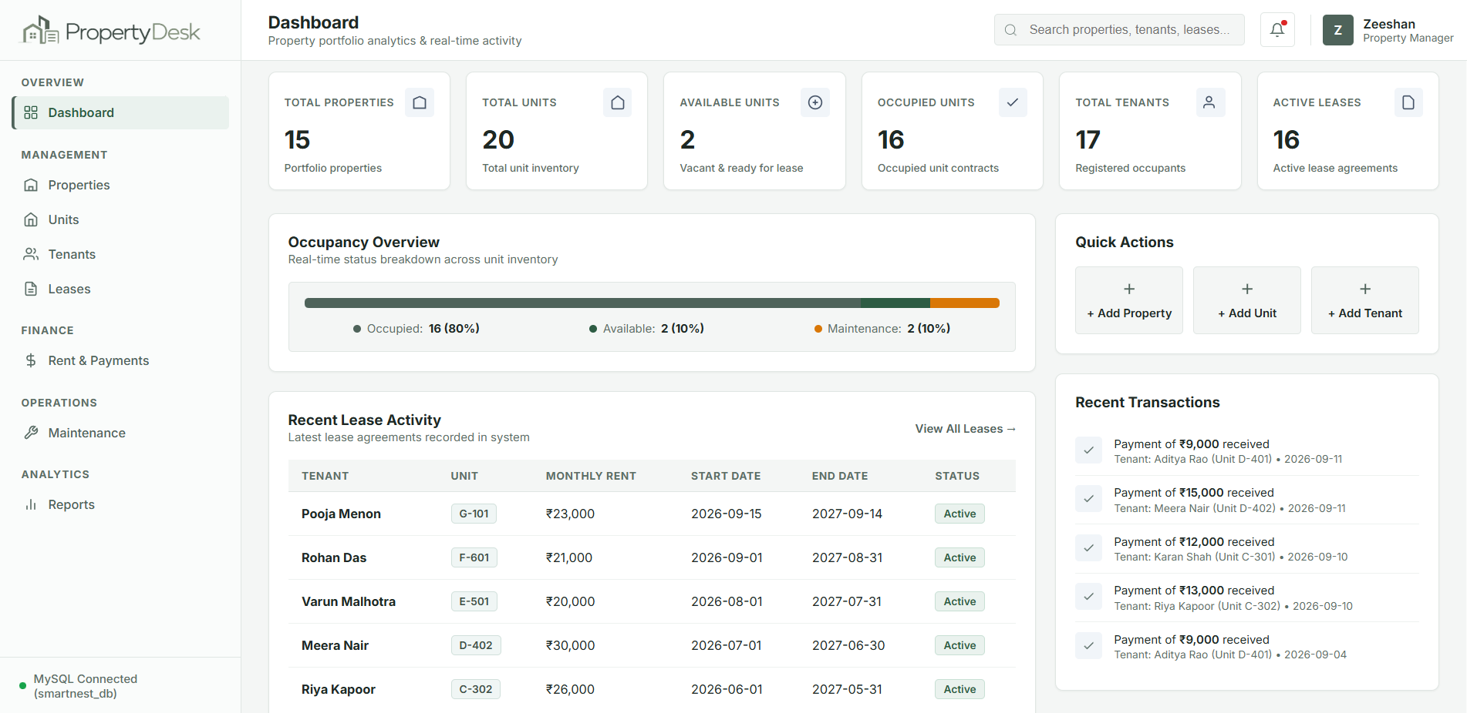
PropertyDesk Dashboard
Dashboard Shows
■ Total Properties
■ Total Units
■ Available Units
■ Occupied Units
■ Total Tenants
■ Active Leases
■ Occupancy Overview
■ Recent Lease Activity
Real-time dashboard statistics are retrieved from the MySQL database.
4

Slide 5
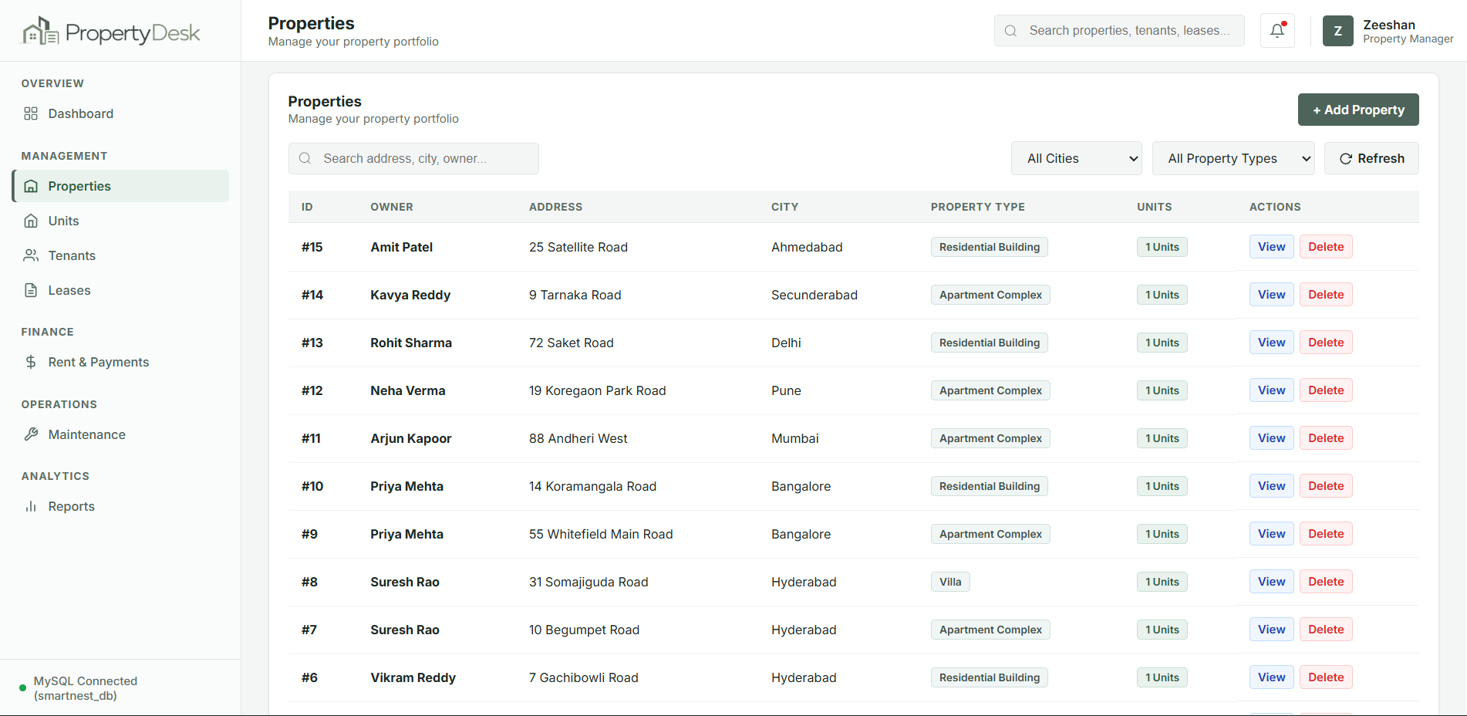
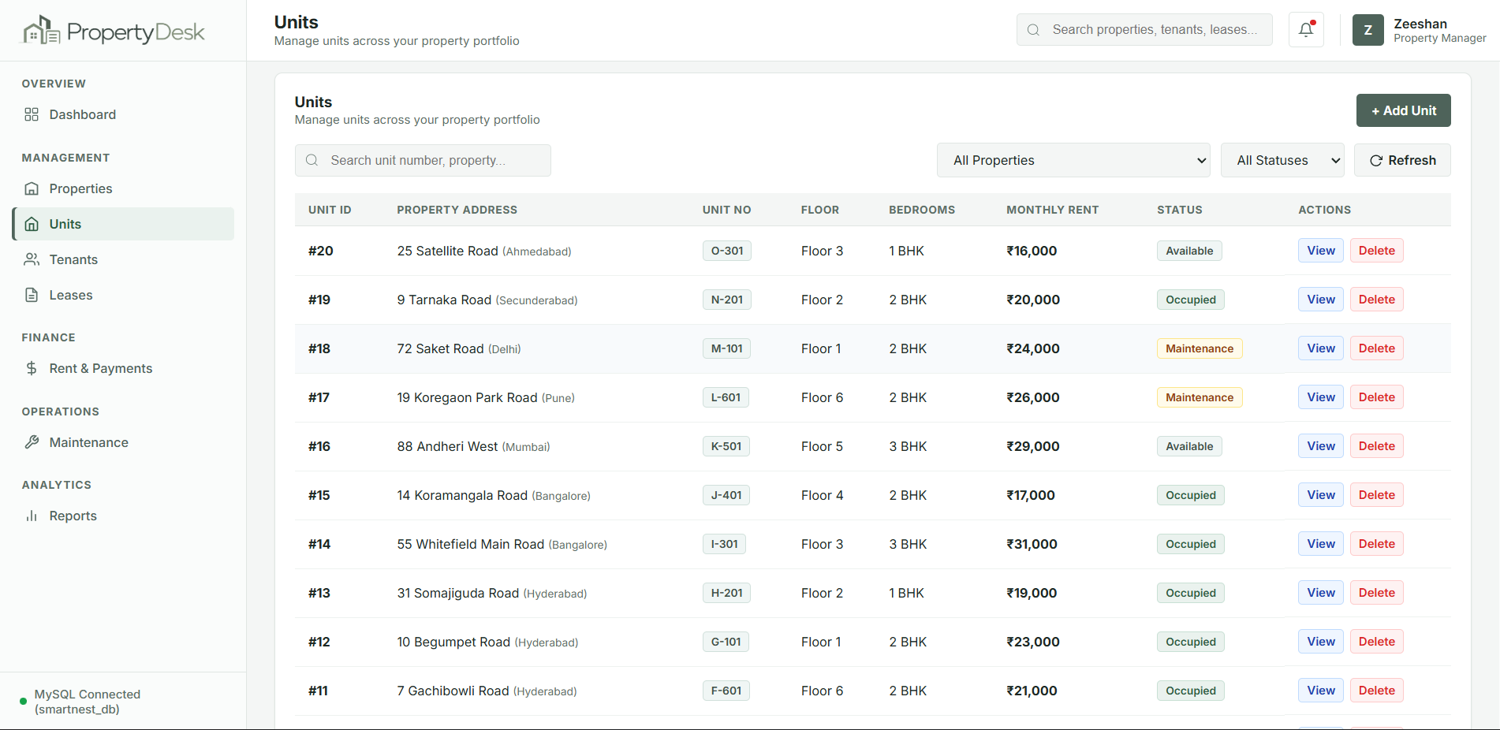
Property & Unit Management
Properties
Units
■ View real property and unit records
■ Search and filter records
■ Add new properties and units
■ View detailed information
■ Delete records with database constraint protection
■ Changes synchronize with MySQL
5

Slide 6
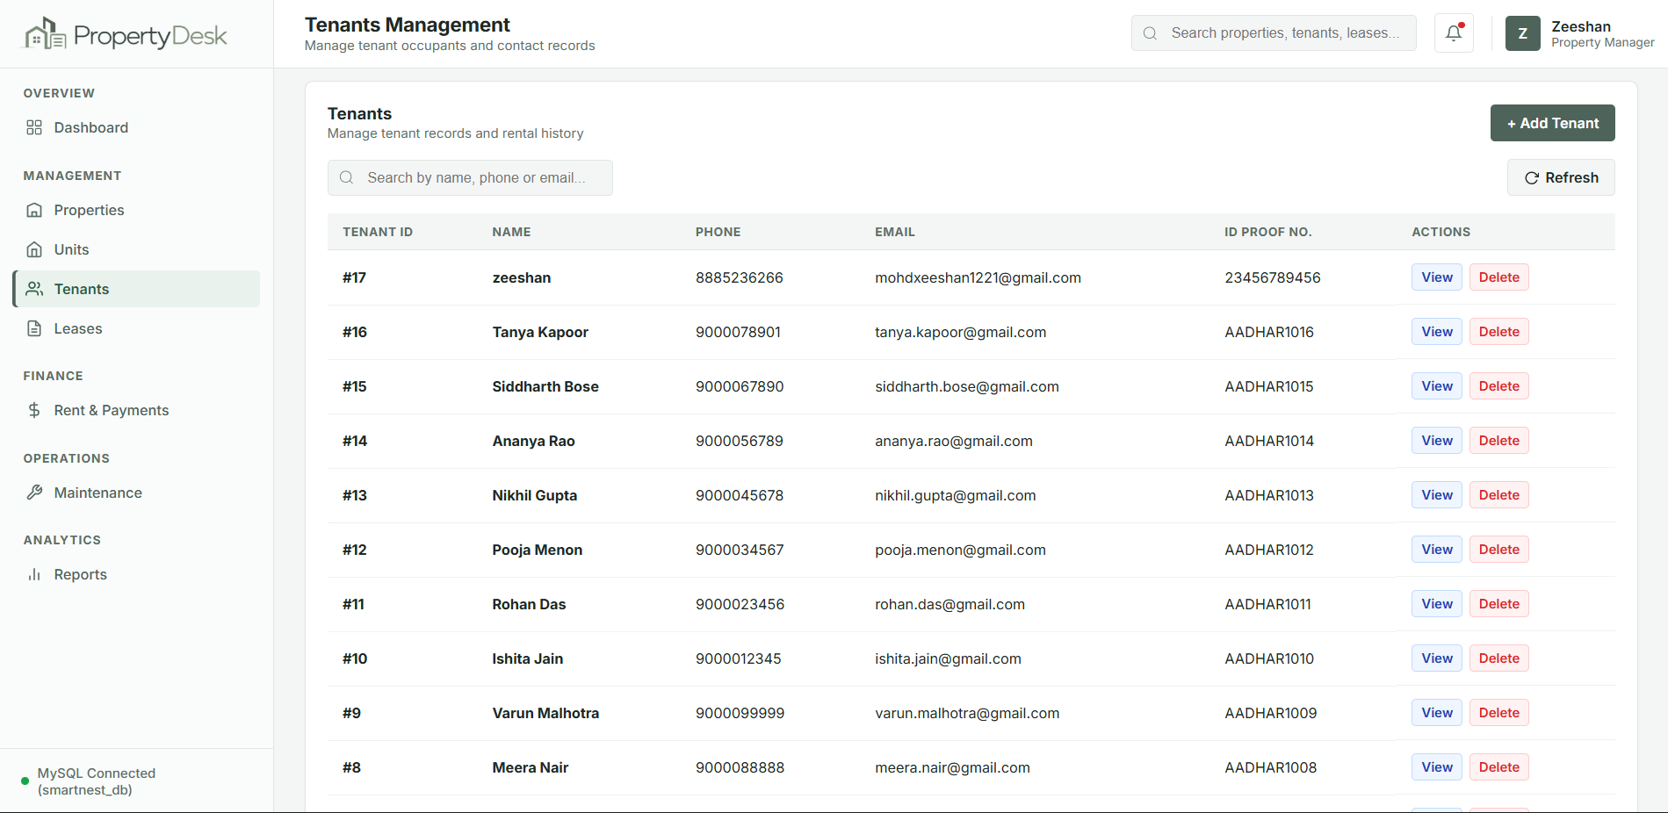
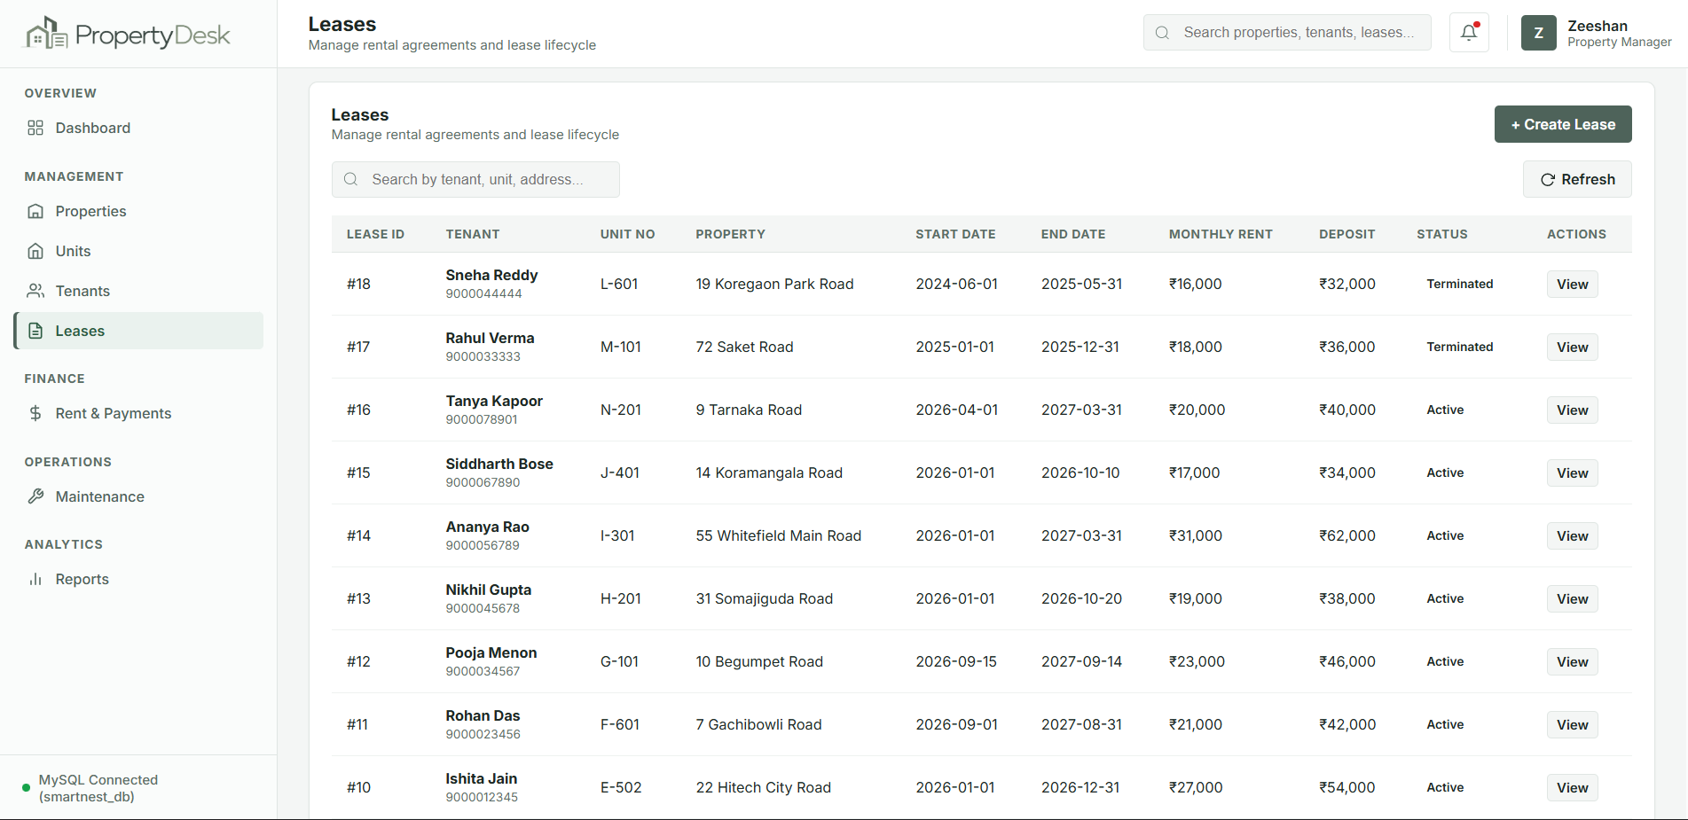
Tenant & Lease Management
Tenants
Leases
■ Manage tenant records
■ Create and view tenant information
■ Connect tenants with rental units
■ Manage lease dates and monthly rent
■ Track Active / Expired / Terminated leases
■ Apply existing database validation rules
A lease connects the tenant and the unit and represents the actual rental agreement.
6

Slide 7
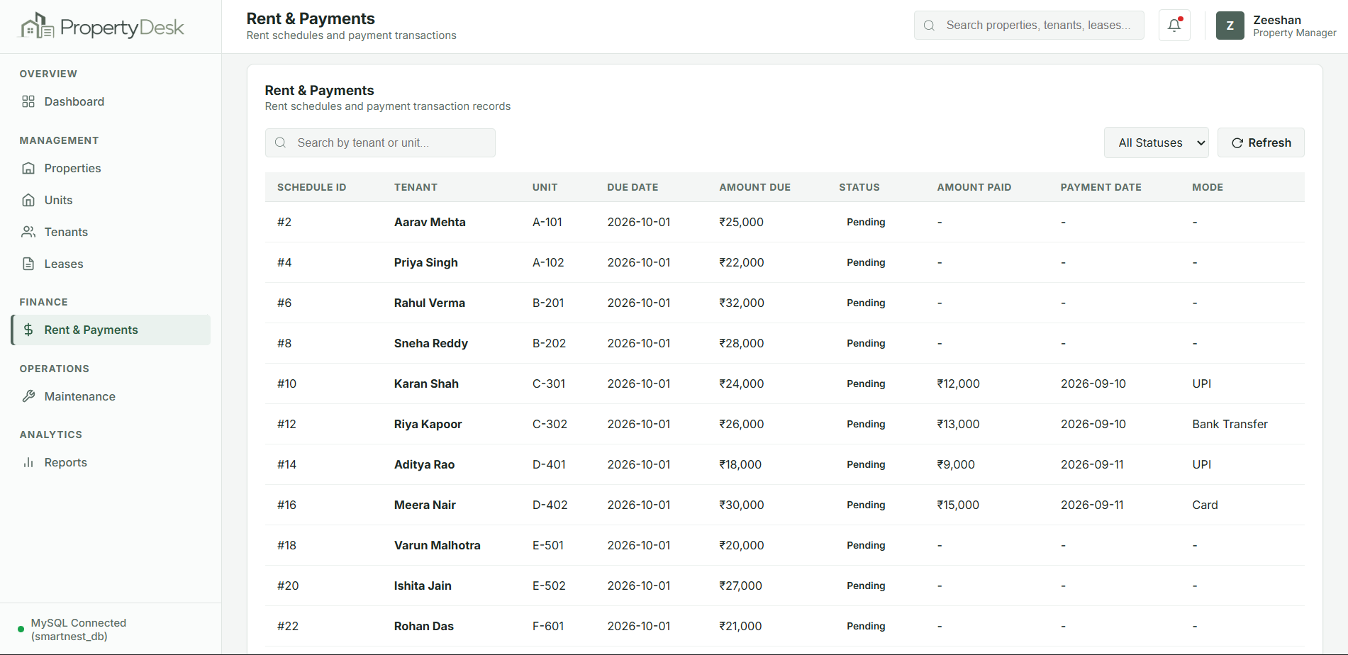
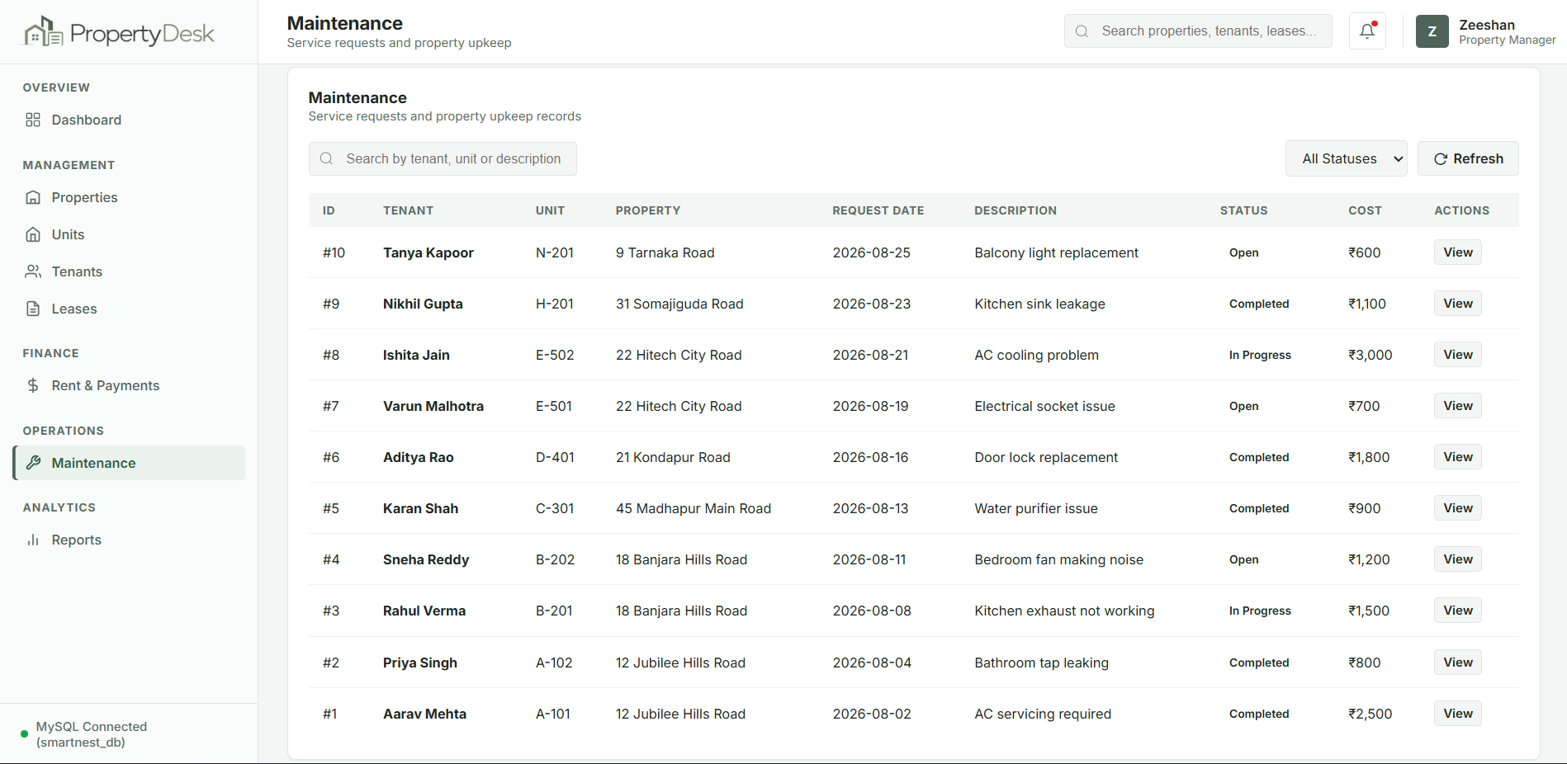
Finance & Operations
Rent & Payments
Maintenance
■ Rent schedules
■ Due amounts
■ Payment tracking
■ Payment validation
■ Maintenance requests
■ Unit and tenant association
■ Request status
■ Maintenance cost tracking
Payment validation and maintenance records are handled through the same MySQL database rules.
7

Slide 8
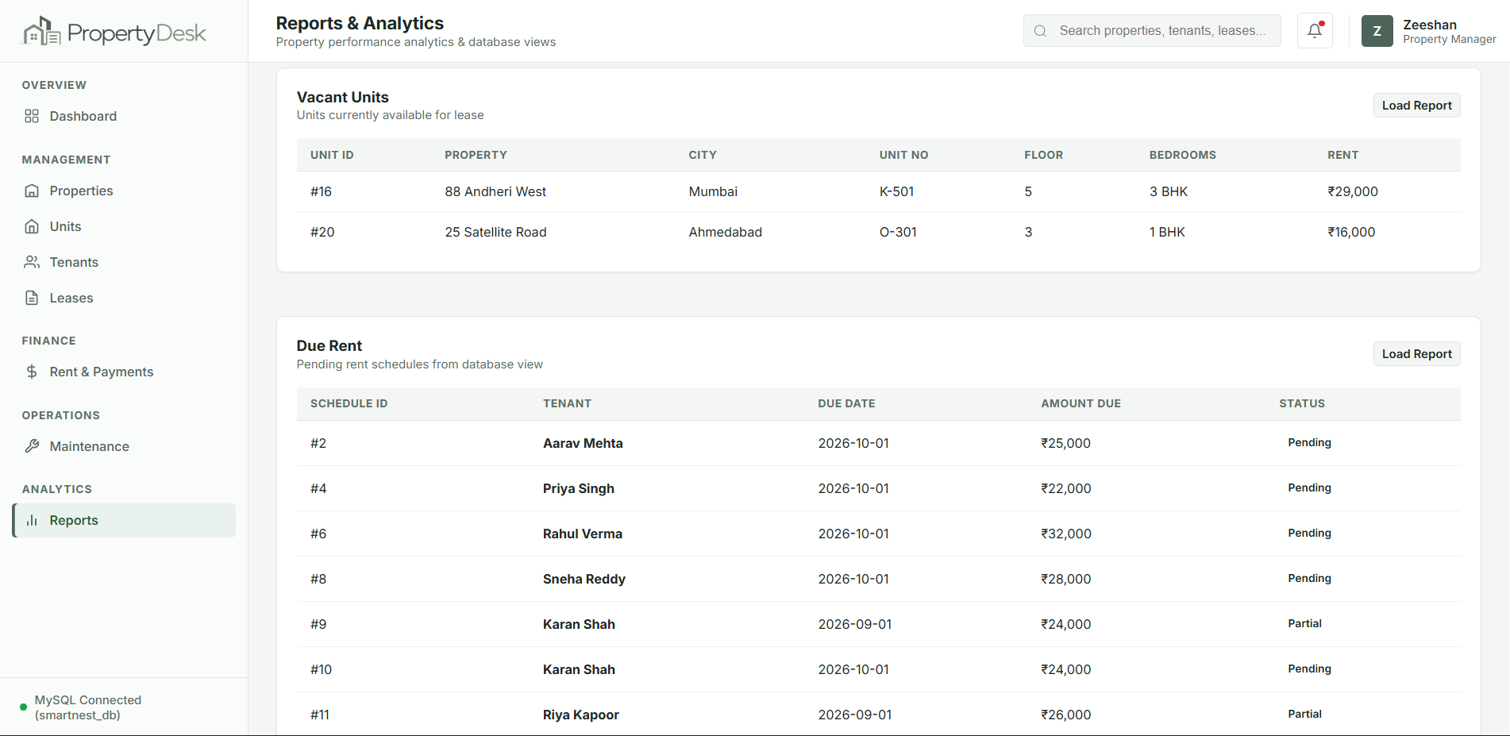
Database-Driven Reports
Reports
■ Vacant Units
■ Due Rent
■ Lease Expiry
■ Owner Income
■ Tenant History
■ Maintenance Requests
Reports are generated from real MySQL data using SQL queries and database views.
8

Slide 9
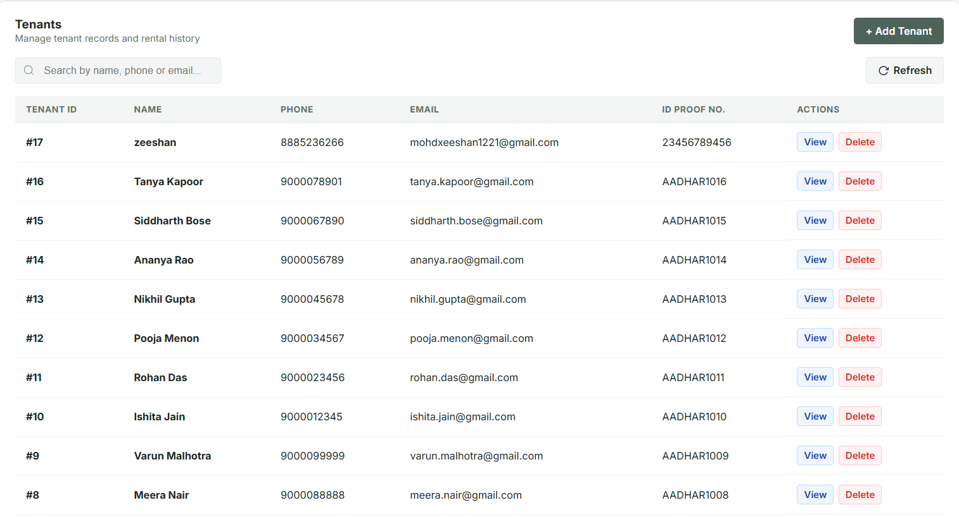
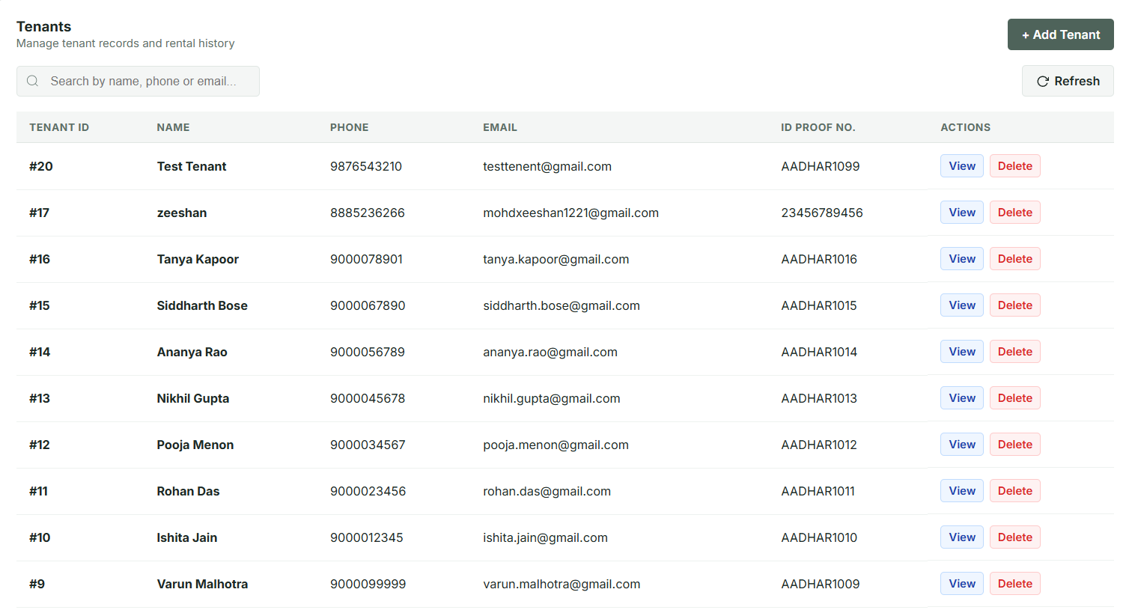
CRUD & Database Validation
INSERT
→
VIEW
→
DELETE
→
VERIFY IN MYSQL
Before insert
After insert (new tenant #20)
Validation
■ Invalid lease dates rejected
■ Negative rent / deposit rejected
■ Unavailable unit cannot be leased
■ Payment cannot exceed amount due
■ Foreign-key constraints protect related records
CRUD Operations
■ Insert • View • Delete • Search
Live demo: one real Insert → View → Delete workflow, then verified in MySQL.
9

Slide 10
Conclusion & Future Scope
Conclusion
Future Scope
■ Centralized rental data
■ CRUD operations
■ Validation and integrity
■ Financial and maintenance tracking
■ Database-driven reports
■ Role-based authentication
■ Automated rent reminders
■ Online payment integration
■ Advanced analytics
■ Cloud deployment
■ Mobile application
PropertyDesk successfully converts the database design into a working property rental and lease management application connected to MySQL.
PROPERTYDESK
Property Rental & Lease Management System
Thank You
10

